Slide 1
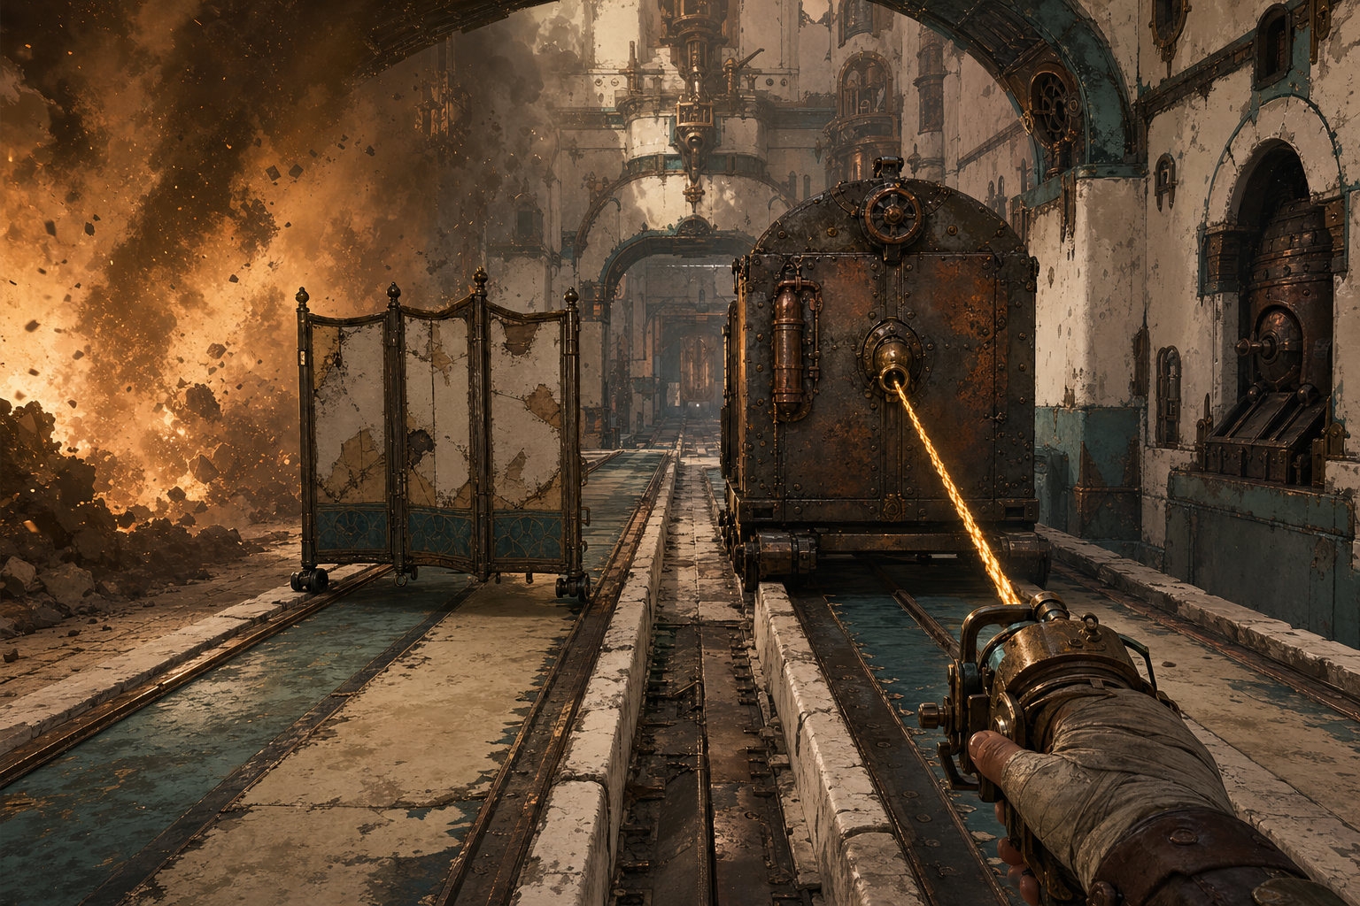
CONCEPT ART
ARCOS FPS
REOPEN THE CINDERWELL PASSAGE
A mobile-first combat-puzzle FPS about revealing hidden fire, moving cover, and choosing how fast to advance.
REVISED CONCEPT • AUGUST 2026

Slide 2
THE PLAYER FANTASY
You are a Route Keeper
A ruined passage is not crossed by firepower alone. Read its danger, reshape its geometry, and reopen the road.
READ
RESHAPE
ENDURE
The scout gives partial intelligence—not answers.
Pull yourself, move cover, and clear the route.
Outrun the Cinderwake while unseen defenders fire.
The Hollow Warden waits at the end as the only required visible enemy.

Slide 3
THE REPEATABLE RHYTHM
Plan briefly. Commit completely.
Every section converts incomplete information into a physical route decision.
1
READ
2
REVEAL
3
MOVE
4
SURVIVE
5
STRIKE
Study the scout map.
Risk exposure to locate fire.
Tether and reposition cover.
Read the bolt and ground trace.
Spend scarce shots—or save them.
READ → REVEAL → MOVE → SURVIVE → STRIKE → ADVANCE

Slide 4
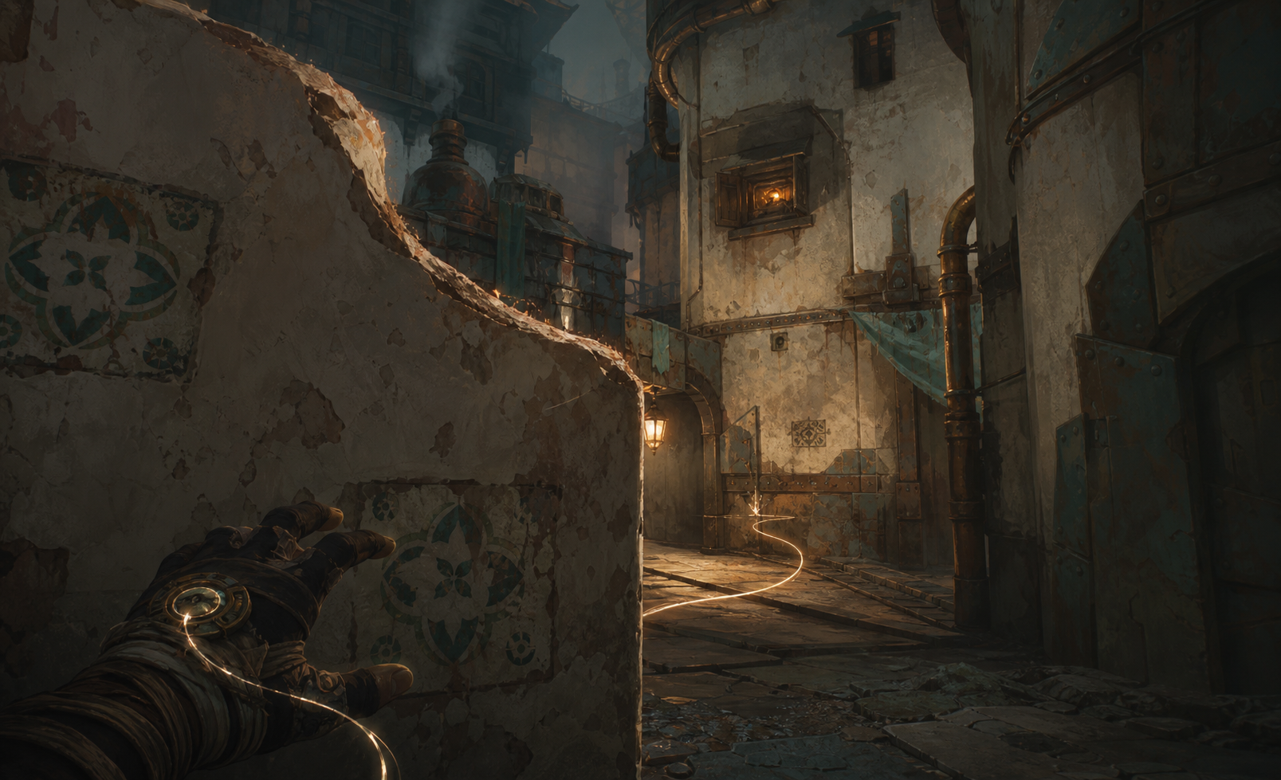
SIGNATURE TENSION
CONCEPT ART
Information has a cost
The defenders stay unseen. Peeking or casting a Route-line pulse reveals a firing aperture—but lets it acquire you.
UNCERTAIN
RECIPROCAL REVEAL
COMMIT
The scout marks a probable threat zone.
You locate the aperture; it locates you.
Move cover, change route, or prepare to dodge.

Slide 5
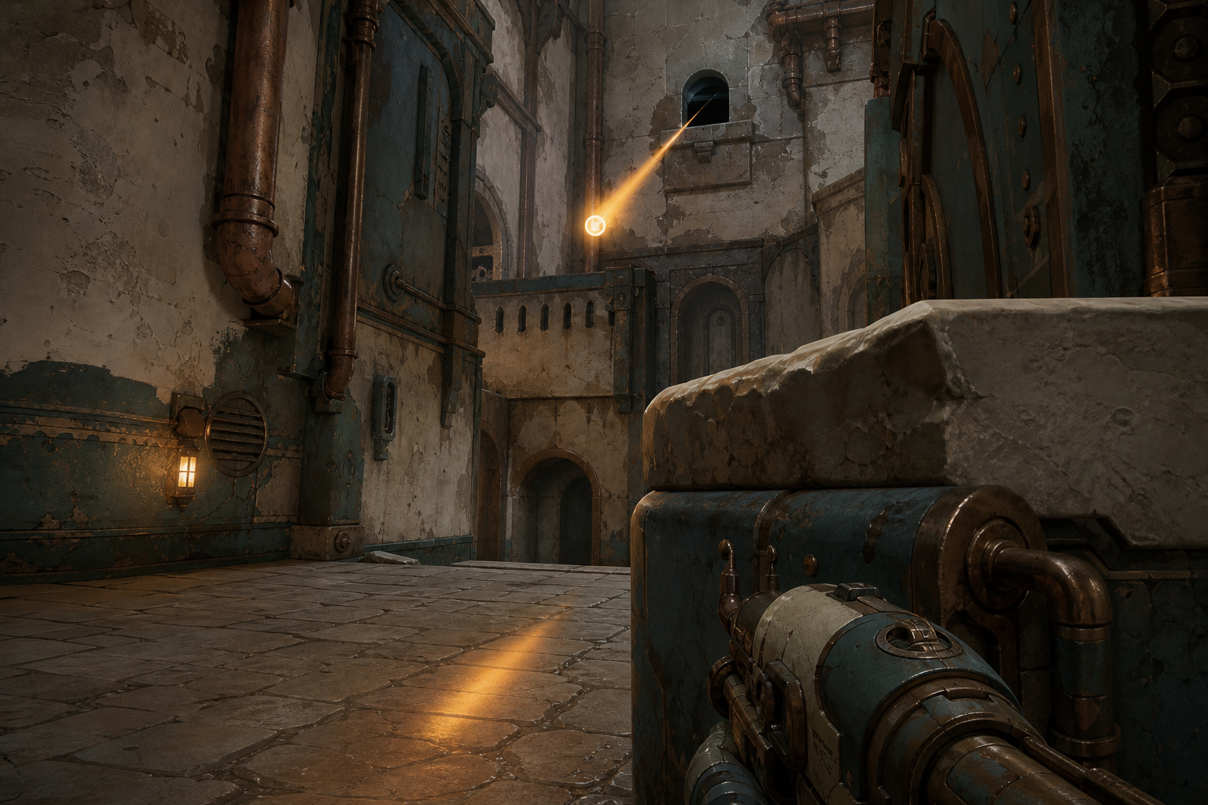
READABLE UNSEEN FIRE
CONCEPT ART
Two moving traces reveal the source
The airborne bolt and its ground reflection or shadow communicate direction, distance, and height—without a minion model.
DIRECTION
HEIGHT
DISTANCE
Both traces point back toward the aperture.
Their vertical separation shows elevation.
Convergence, motion, and parallax show range.

Slide 6
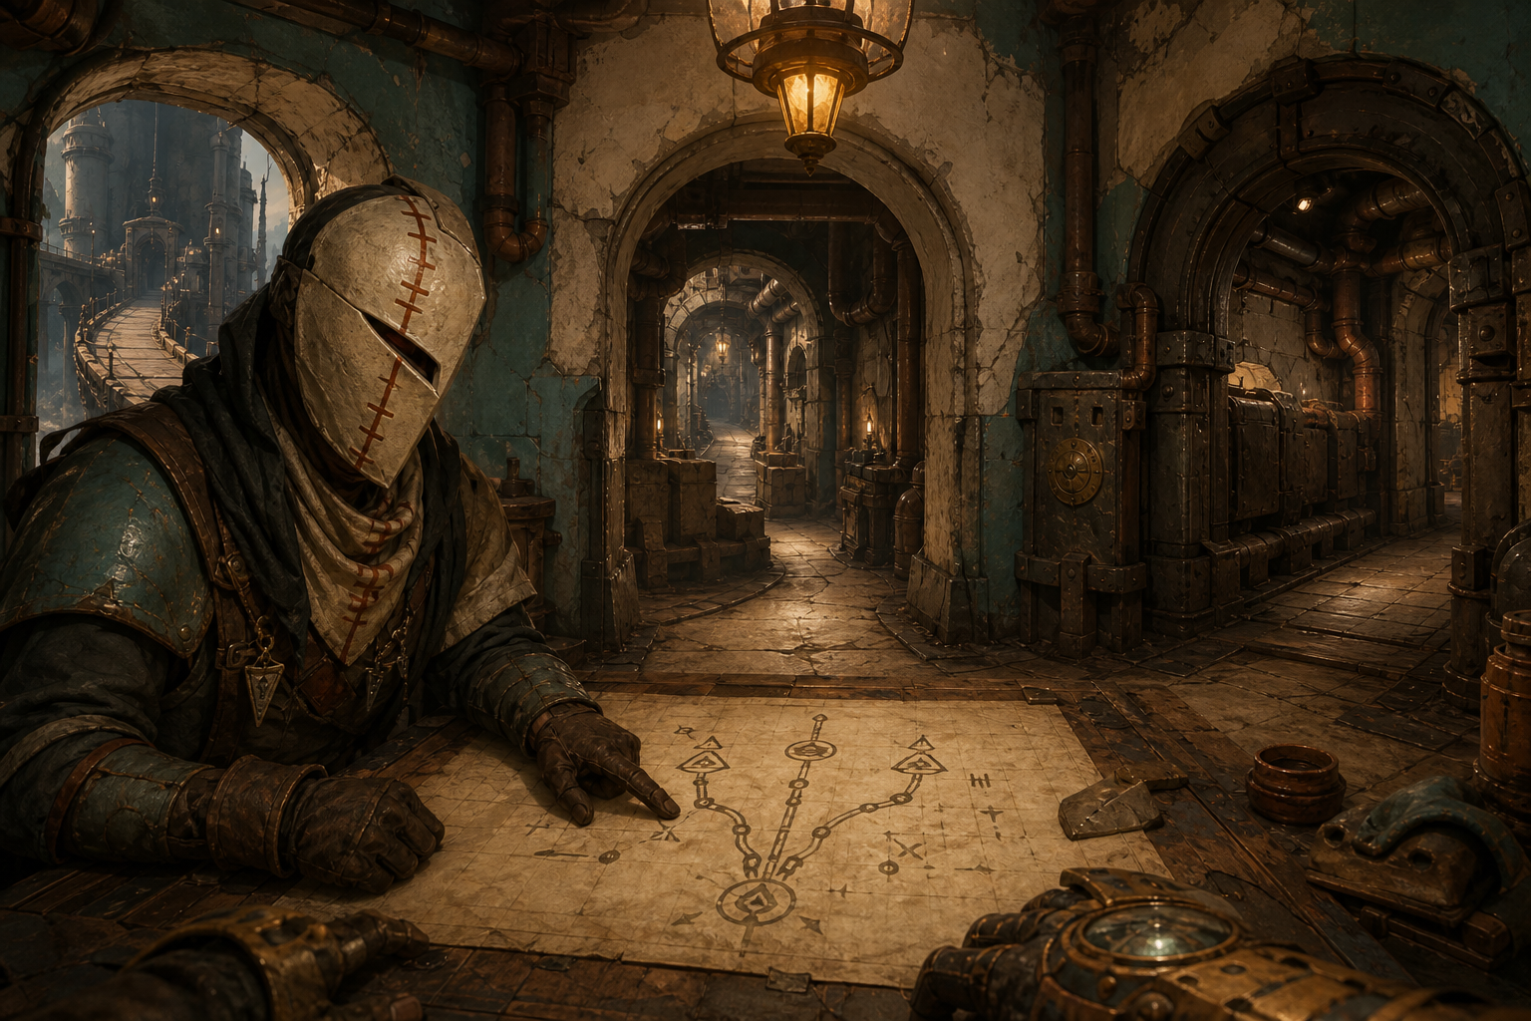
BEFORE THE RUN
CONCEPT ART
Three routes. Partial intelligence. One choice.
The scout maps structure, anchors, cover weight, and probable fire—but does not solve the section.
HIGH
CENTER
LOW
Fast • exposed
Balanced • destructible cover
Slow • heavy protection

Slide 7
THE CENTRAL DECISION
CONCEPT ART
Protection competes with time
Light cover moves quickly and breaks. Heavy cover holds—but the Cinderwake does not wait.
LIGHT
ROUTE-LINE
HEAVY
Fast to move • fragile
Pull the heavy slab into your lane
Slow to move • durable

Slide 8
CONSTRAINED POWER
The tether is unlimited. The shots are not.
Movement remains expressive; offense remains a decision.
ROUTE-LINE
KILNLOCK
Pull yourself under low fire, cross gaps, reach anchors, and reposition cover.
Disable an aperture, break an obstruction, interrupt danger, or preserve ammunition for the Warden.
UNLIMITED
SCARCE
The tether changes position and possibility—not damage output.

Slide 9
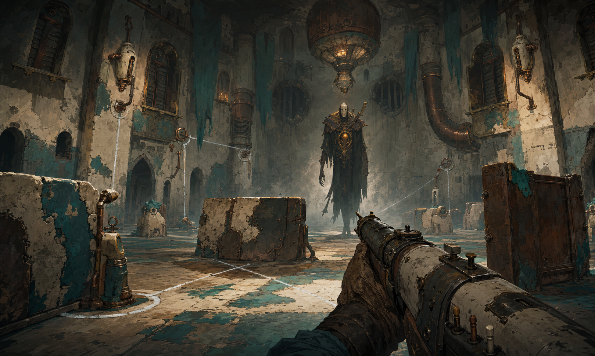
THE CULMINATION
CONCEPT ART
The Warden waits at the end
The only visible enemy tests every learned system: route reading, moving cover, projectile interpretation, timing, and restraint.
READ
RESHAPE
COMMIT
Recognize charge and recovery.
Use cover and anchors in the chamber.
Spend the shots you managed to save.

Slide 10
THE MVP PROOF
CONCEPT ART
ONE PASSAGE.
ONE UNSEEN FIRING LANE.
ONE MEANINGFUL CHOICE.
A 5–8 minute mobile-first slice proves reciprocal reveal, paired projectile traces, Route-line traversal, light-versus-heavy cover, Cinderwake pressure, scarce shots, and arrival at the Warden.
READ THE ROUTE. REVEAL THE THREAT. REOPEN THE PASSAGE.

